Slide 1
✅ Phase IV: Database (Pluggable Database) Creation and Naming
Objective:
The goal of Phase IV is to create a pluggable database (PDB) in Oracle, configure the admin user, and ensure proper file management.
Key Steps:
Create a PDB with the proper naming convention.
Create an admin user with DBA roles.
Configure file management settings.
Open and save the PDB state for further use.

Slide 2
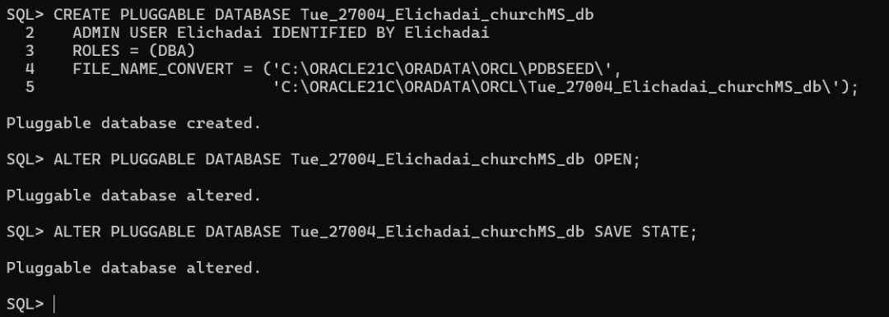
Create the Pluggable Database (PDB)

Slide 3


Slide 4
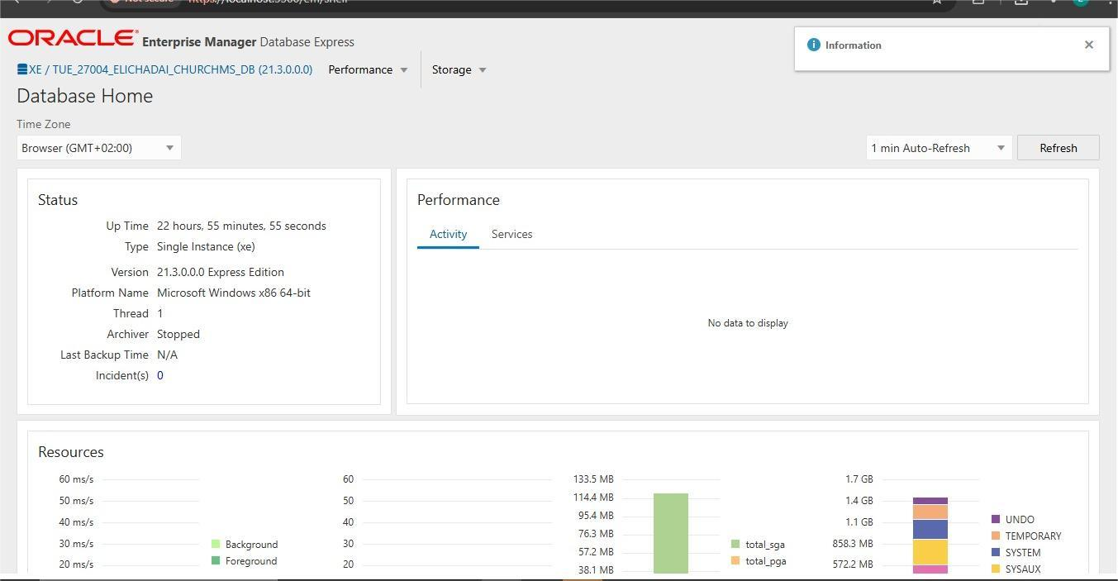
2. Oracle Enterprise Manager (OEM) Setup

Slide 5
